Slide 1
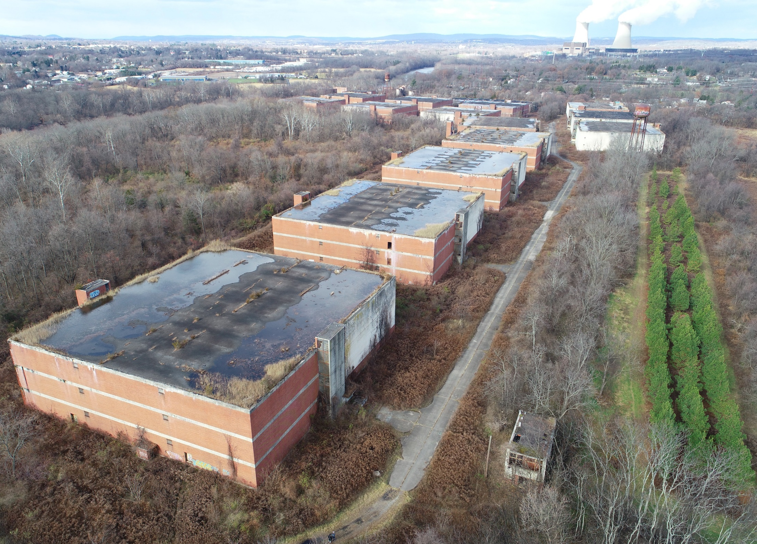
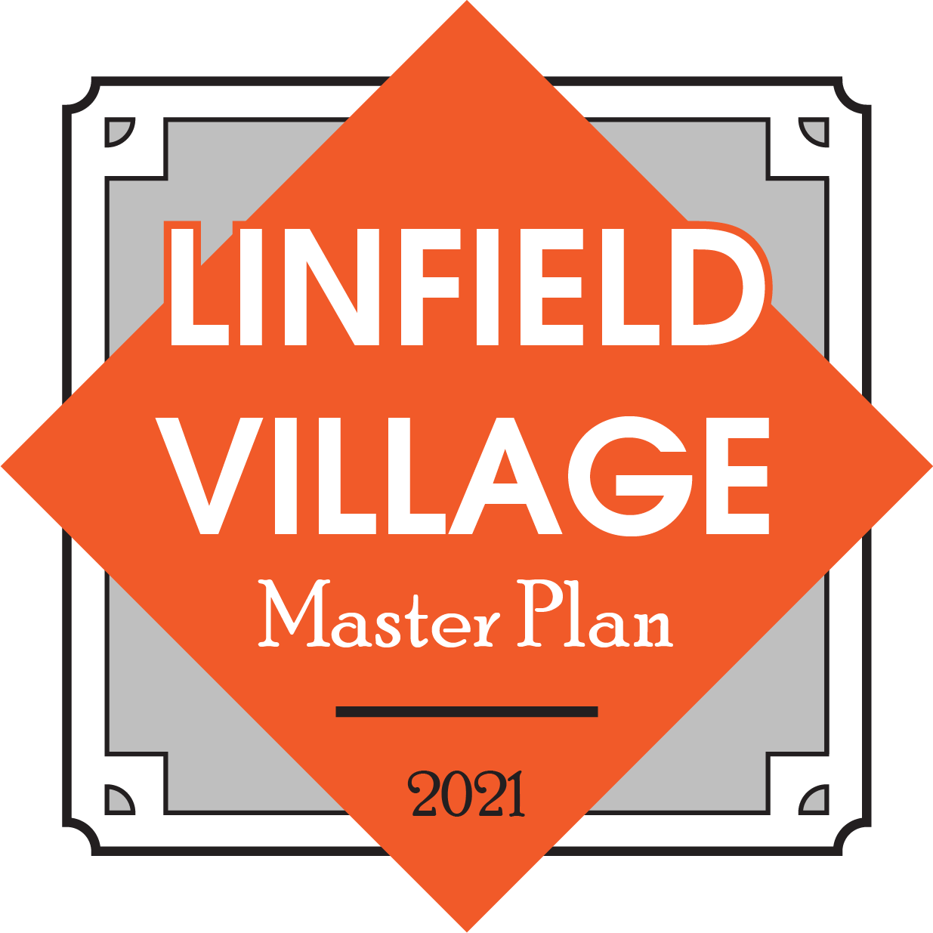
Committee Meeting 6 – September 8, 2021

Slide 2
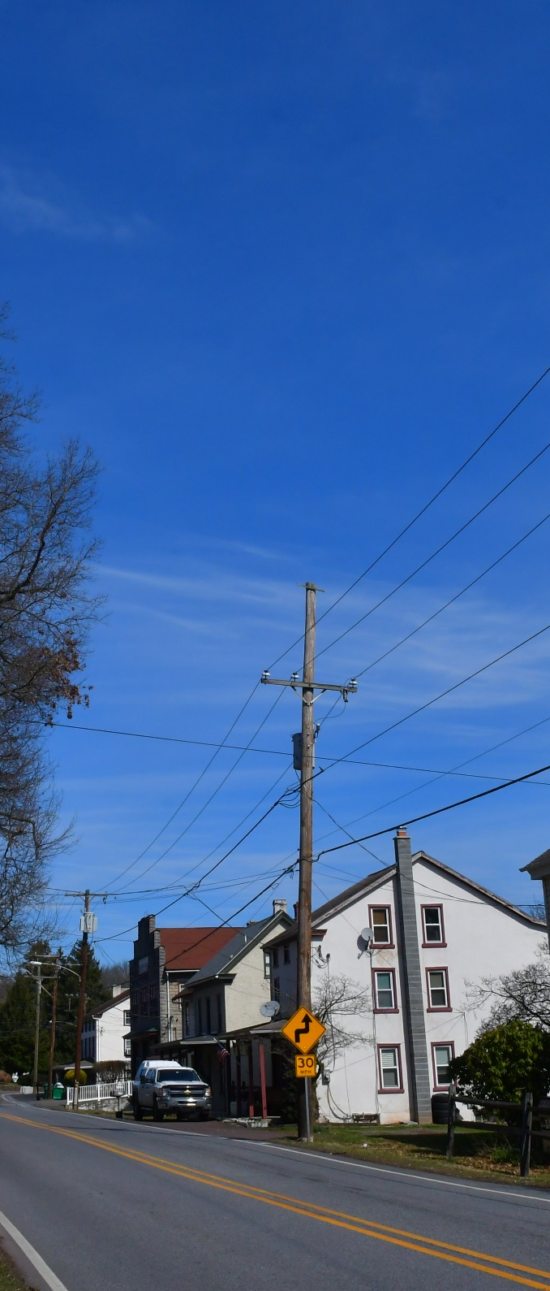
Agenda
Introductions
Project Schedule
Review Previous Meetings
  Committee Meeting 4 – May 20, 2021
  Committee Meeting 5 – June 16, 2021
Concepts
Discussion
Next Steps

Slide 3
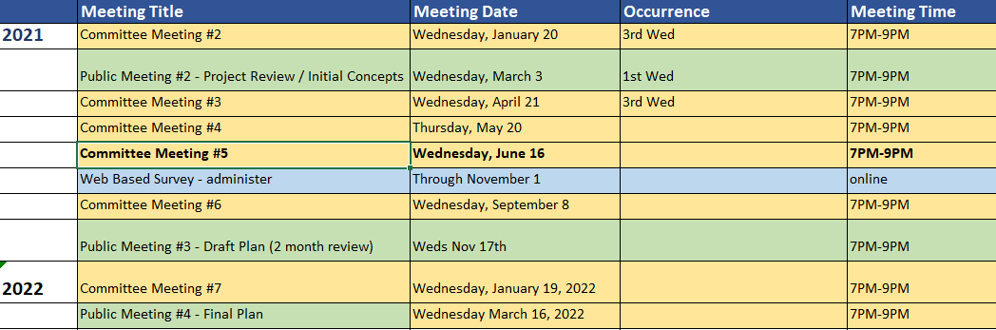
Project Schedule

Slide 4
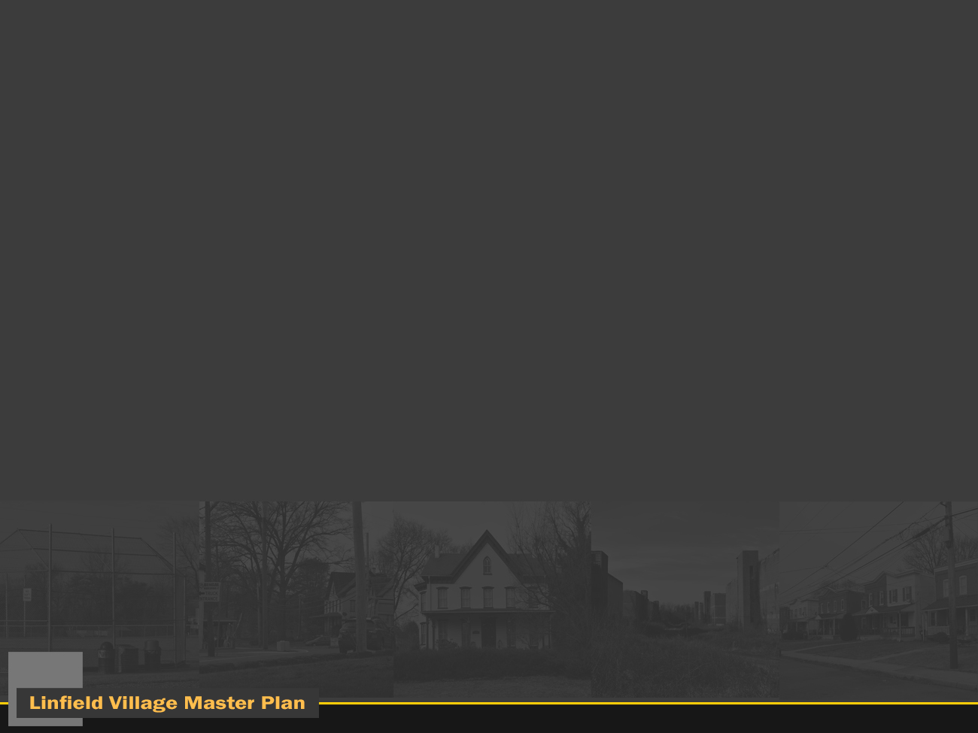


Introduction
Simone Collins Landscape Architecture
  610.239.7601
  Peter Simone, RLA, FASLA
    psimone@simonecollins.com
  Pankaj (PJ) Jobanputra, AICP
    pjobanputra@simonecollins.com
  Joe Wallace
    jwallace@simonecollins.com
  Geoff Creary
    gcreary@simonecollins.com
4Ward Planning
  267.480.7133
  Todd Poole
    tpoole@landuseimpacts.com

Slide 5
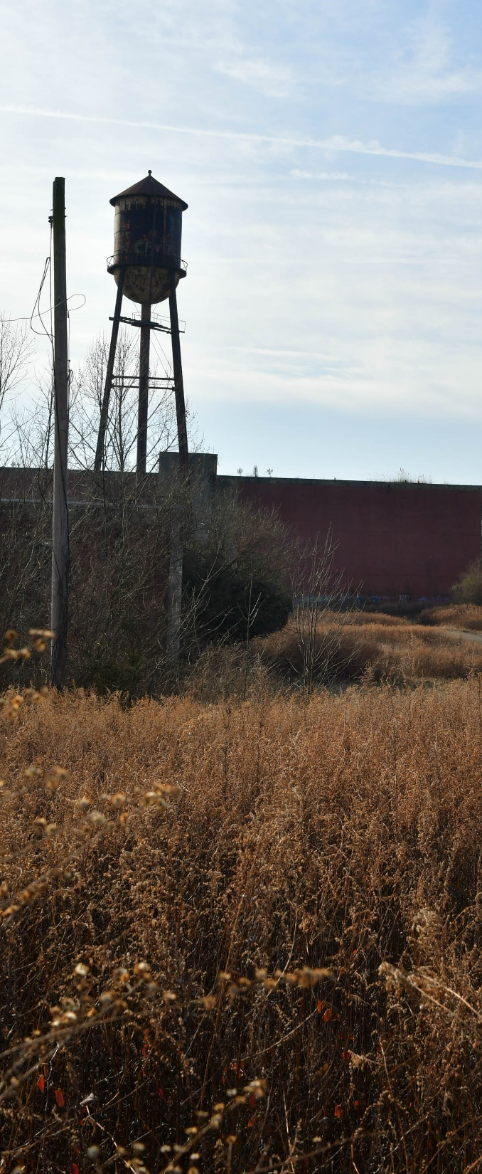
Thank you, Linfield Village Master Plan Committee:
William DeGideo
D. Elaine DeWan
Thomas DiBello
Linda Irwin
Patricia Kaufman
Robert Kleckner
Michael McCloskey(BOS Liaison)
Kevin Rafuse
Jody Roberto
Dennis Rumler
Alexandria Sasek
Margie Schweitzer

Slide 6
Review of
Committee Meeting 4 (May 20, 2021)
Discussion :
  Publicker site:
  Private sector development
  Auto storage - generally not desirable, are they even viable?
  Large scale residential – generally not seem as desirable.
  Some mix of small commercial / retail
  Large industrial likely not viable
  Indoor rock climbing or some other form of recreation / entertainment –
  Township could purchase Publicker site as park with dedicated open space
  The committee discussed the idea of extending the plan further into the future – we can keep survey open as long as the committee wishes.
  What does redevelopment of Publicker really mean in terms of traffic?

Slide 7
Review of
Committee Meeting 4 (May 20, 2021)
Discussion :
  Village
  Streetscape improvements have been discussed / “promised for years
  Streetscape improvements are an investment
  Next few years may be good time for streetscape funding?
  Linfield sports park purchased with bond (does not have to remain open space) – possible future rail station?
  Redevelopment of village makes sense – already a “brownfield”
  Traffic issues is really a “speeding” issue
  There is infill residential development pressure in the village NOW.
  We need to design a better roadway connectivity system now, since once new infill is constructed, opportunities will be lost.
  What about a one-way pairs concept?
  Committee Agreed to advance Village roadway concept design – seek BOS agreement and place roadway concepts on Official Map.

Slide 8
Review of
Committee Meeting 5 (June 16, 2021)
Discussion :
  SC reviewed one-way pair concept for village center, conceptual roadways, and conceptual traffic impacts from potential development.
  Committee discussed importance of short-term traffic calming in the Village.
  Committee discussed golf course as future alternative open space opportunity.
  Discussed that road improvements are relatively low cost. If Publicker develops, this could pay for all or some of the roads. It would all be a part of the negotiation.
  Committee reviewed and discussed the Level of Service preliminary analysis prepared by TPD.
  Committee discussed the future of affordable housing in the Village.

Slide 9
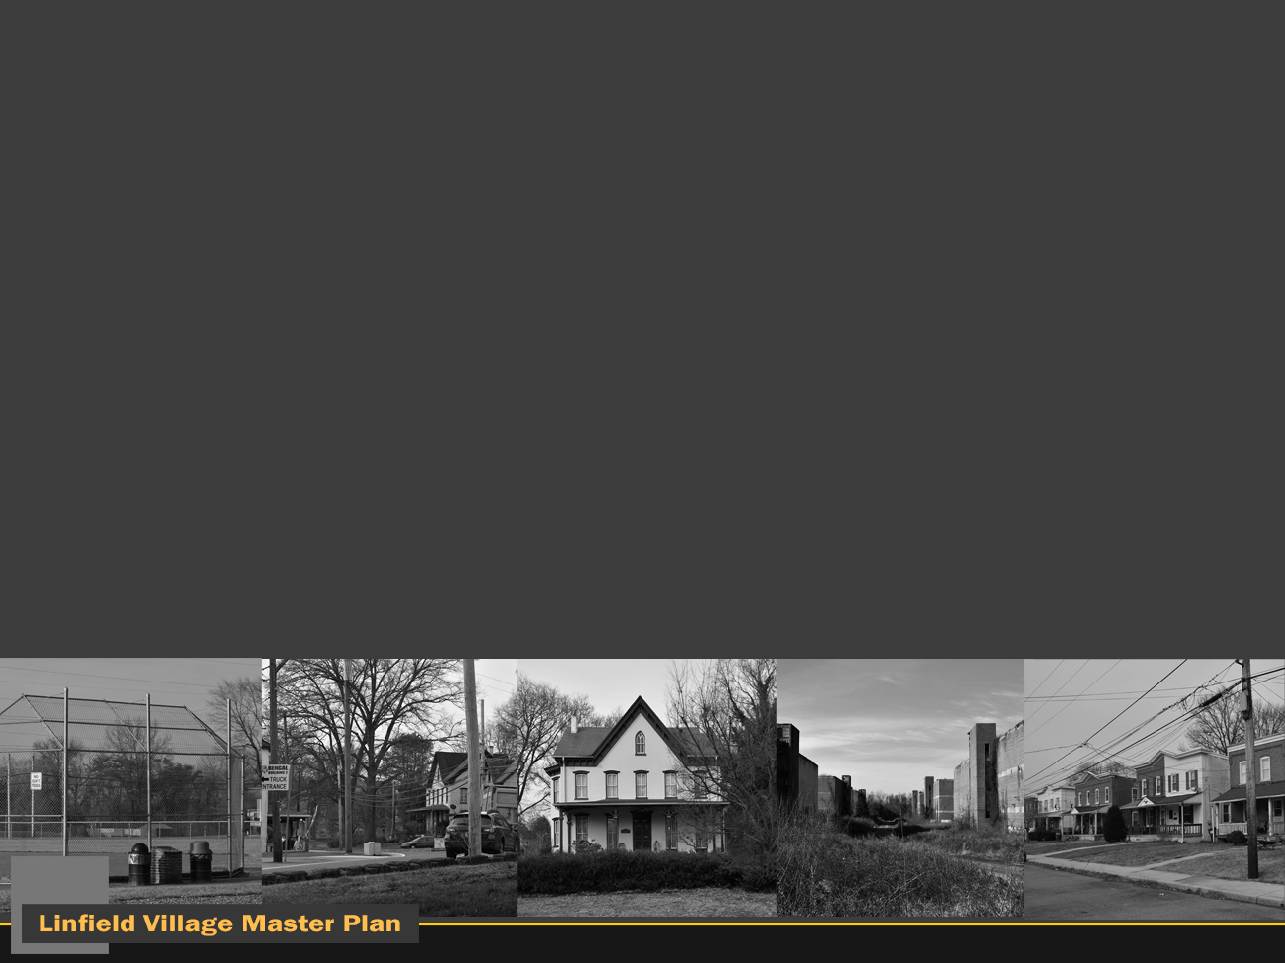
Concepts

Slide 10
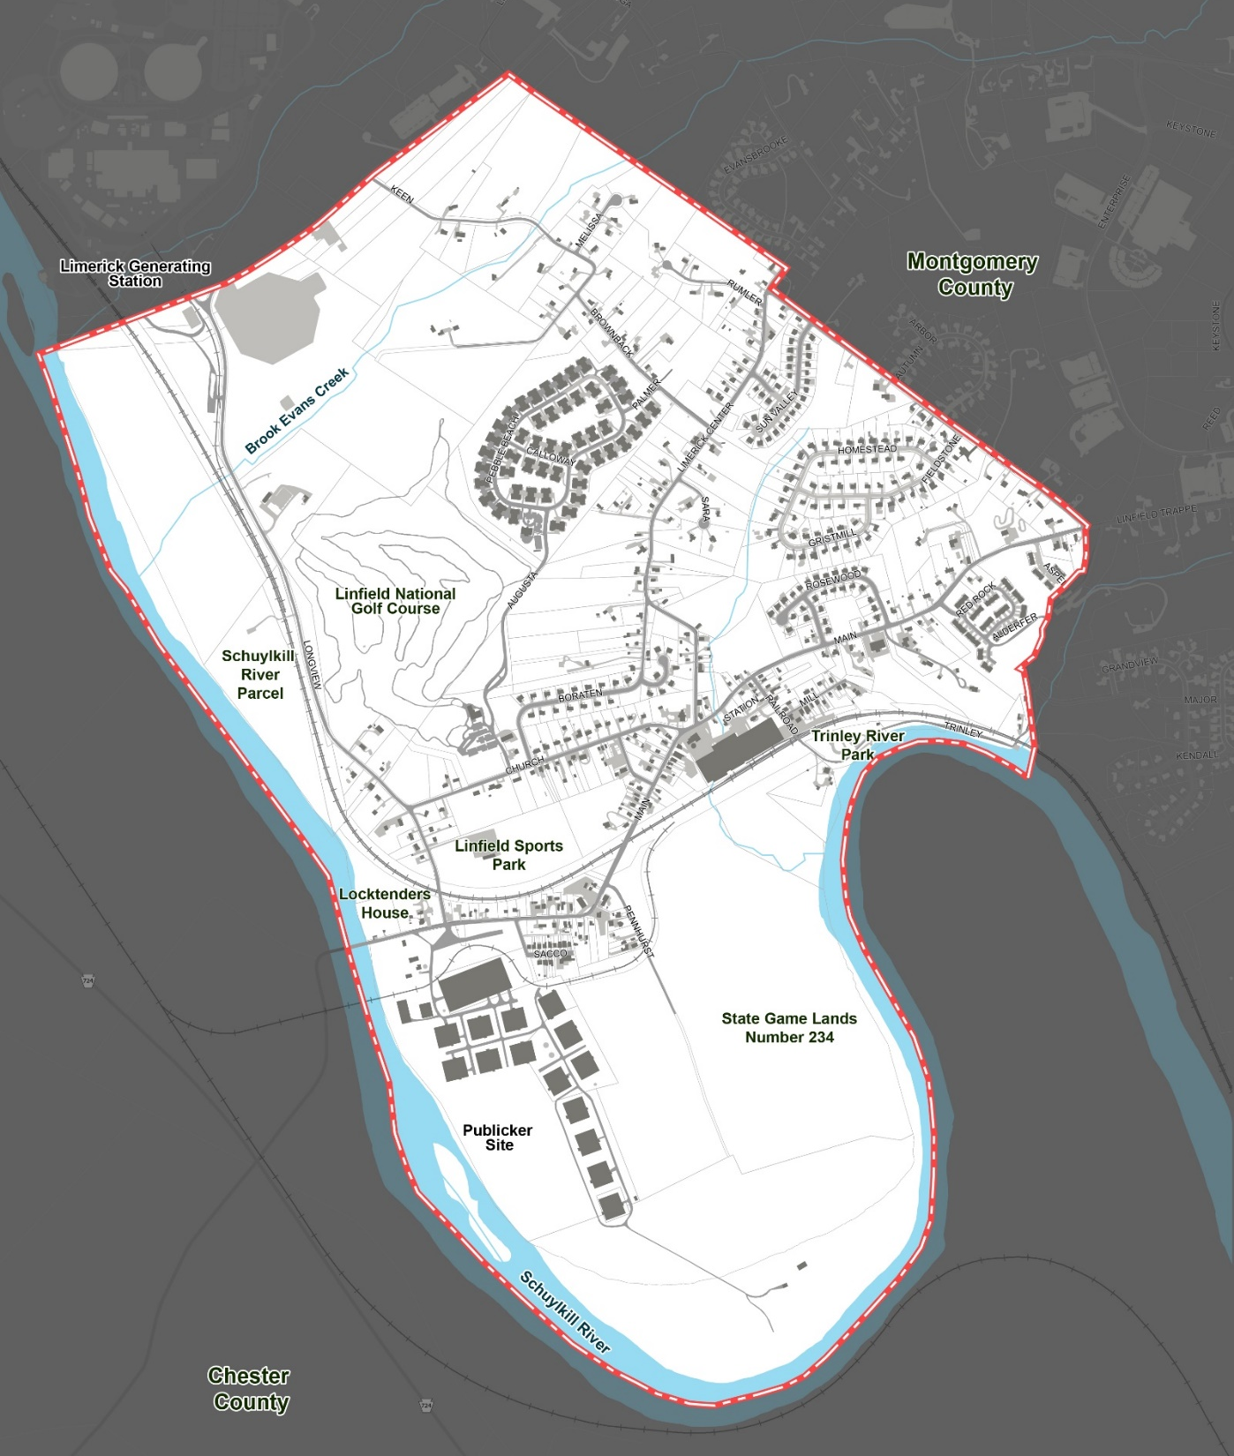
Project Area

Slide 11
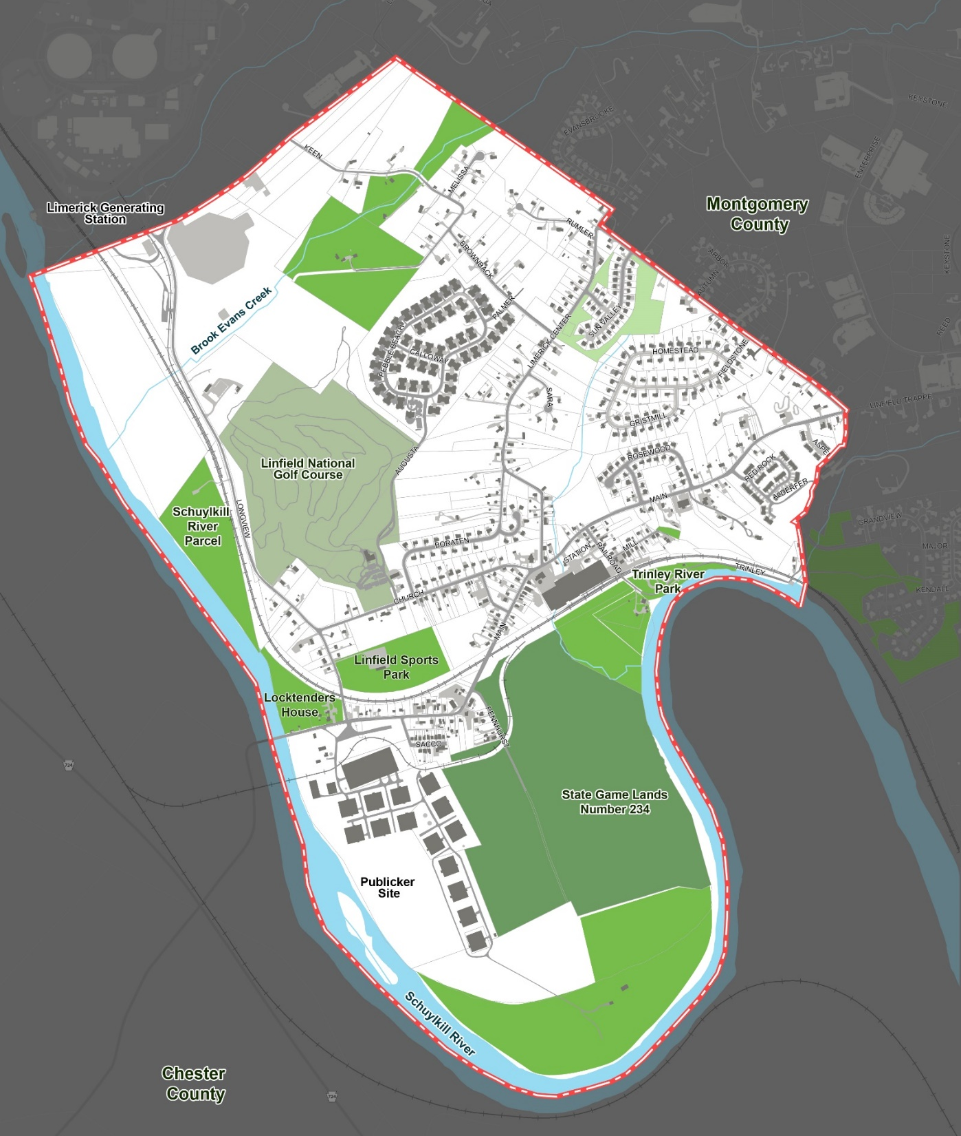
Open Space

Slide 12
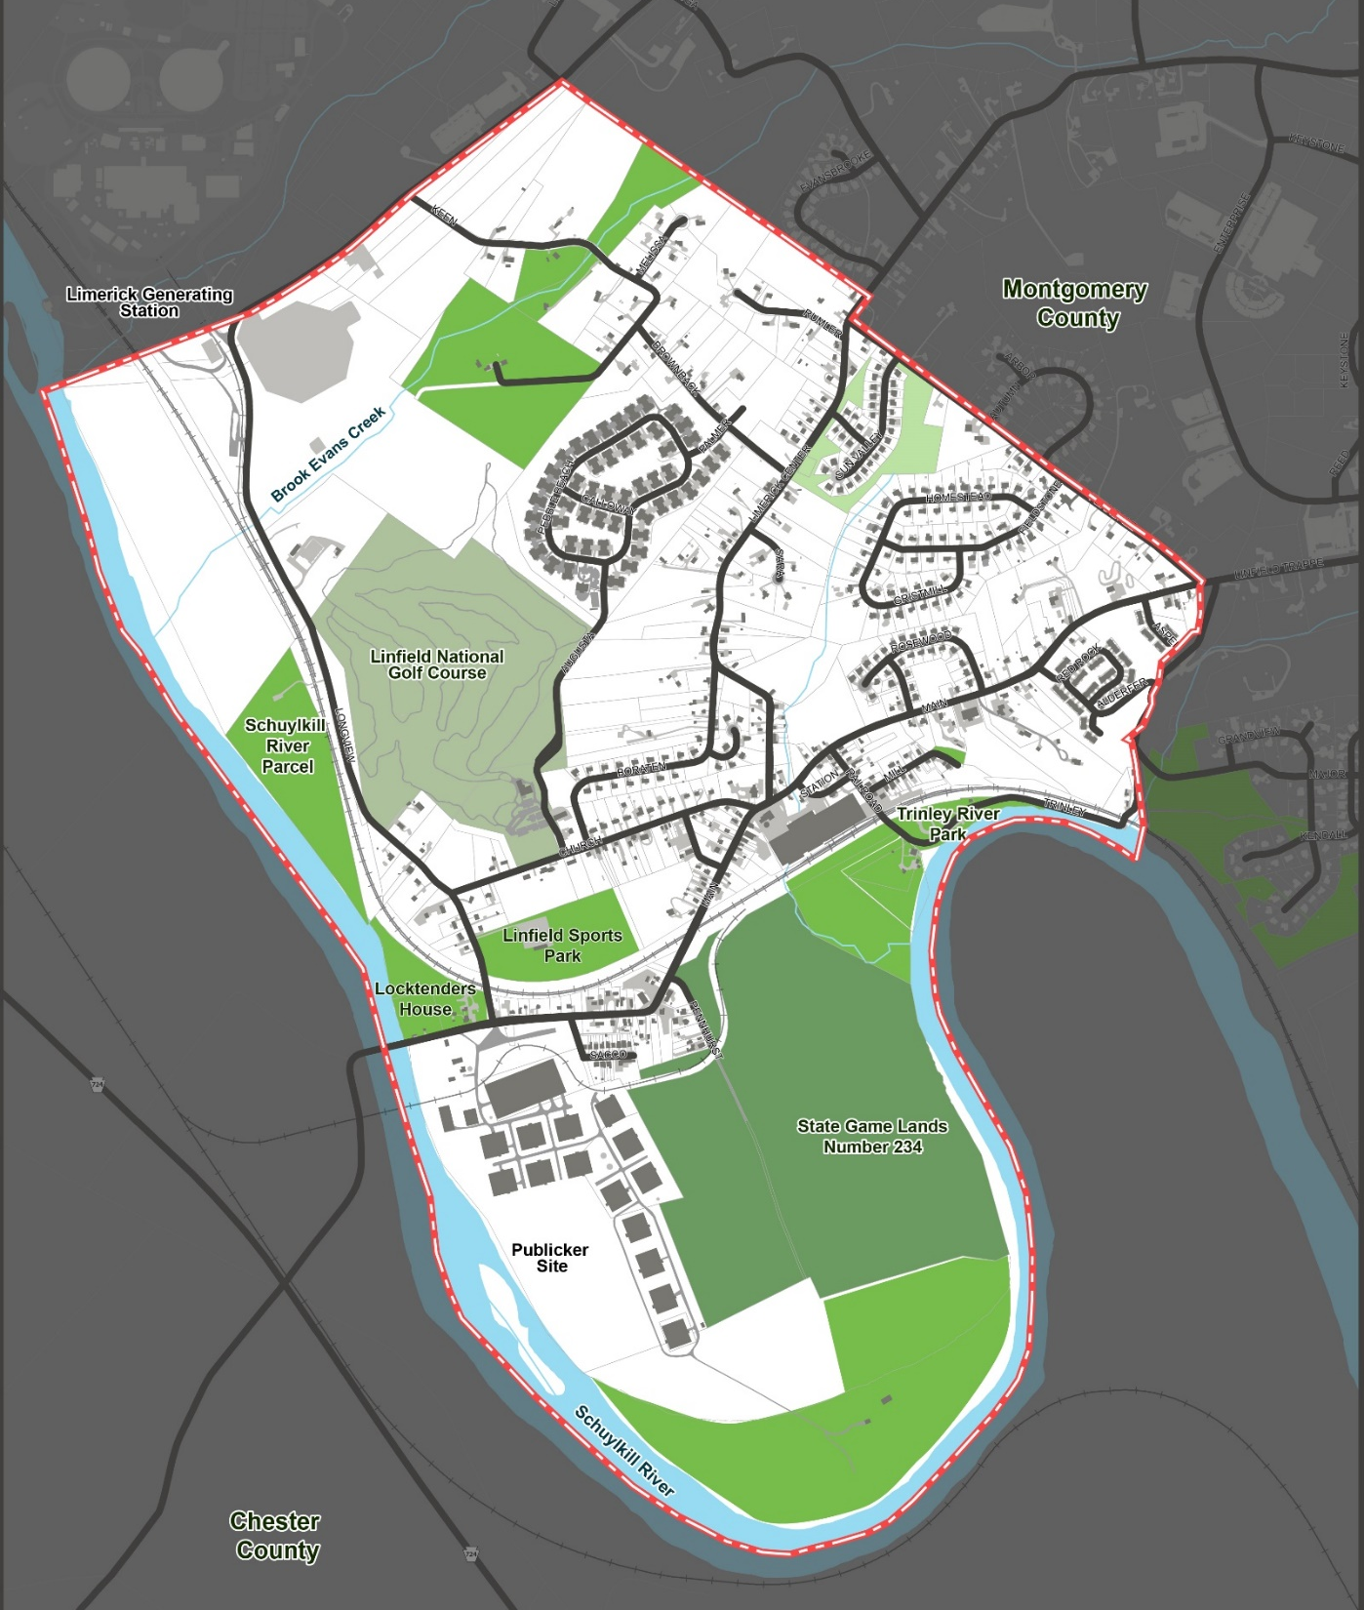
Existing Roads

Slide 13
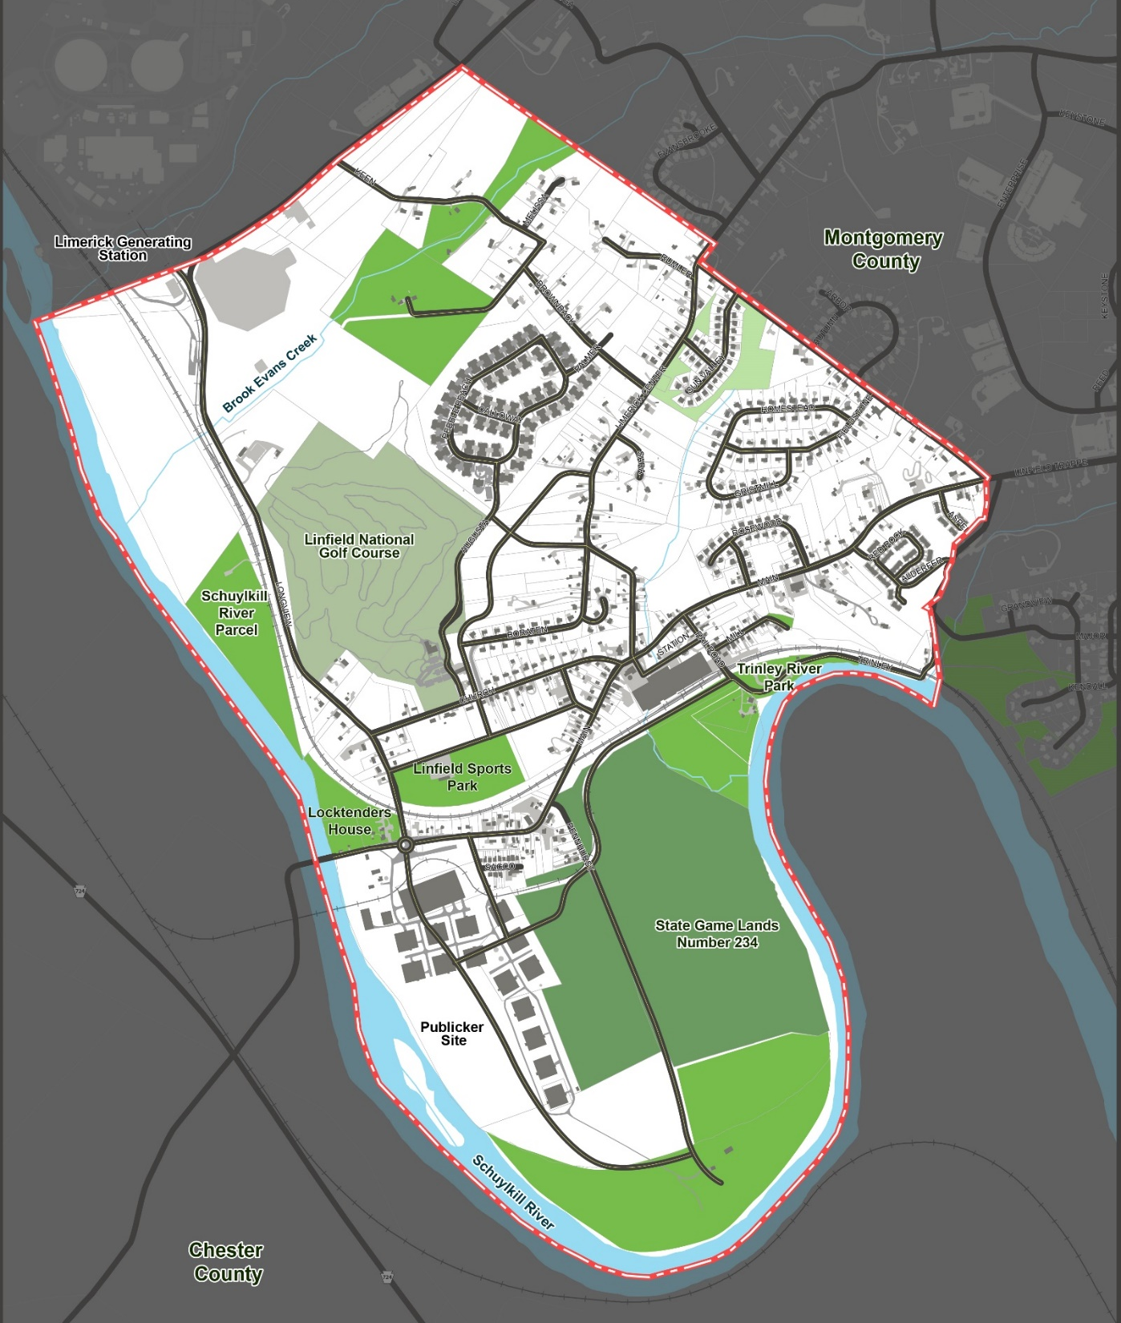
Conceptual Roads

Slide 14
Conceptual Roads

Slide 15
Conceptual Roads

Slide 16
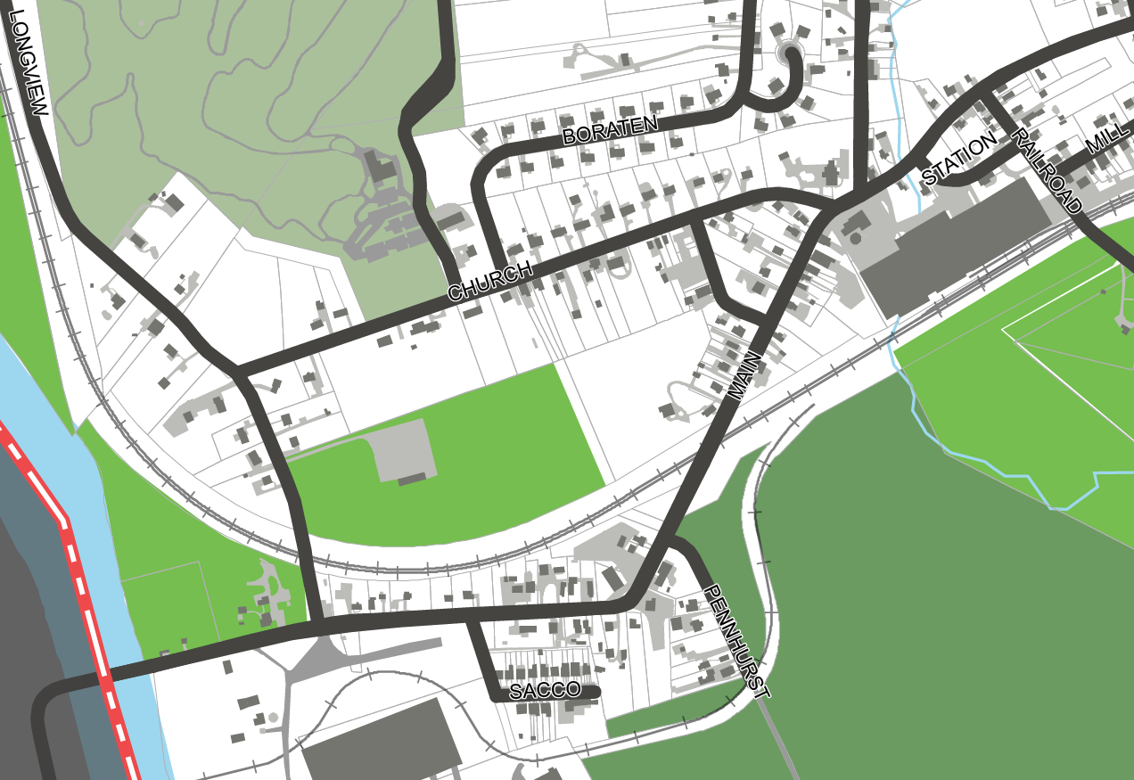
Existing Roads

Slide 17
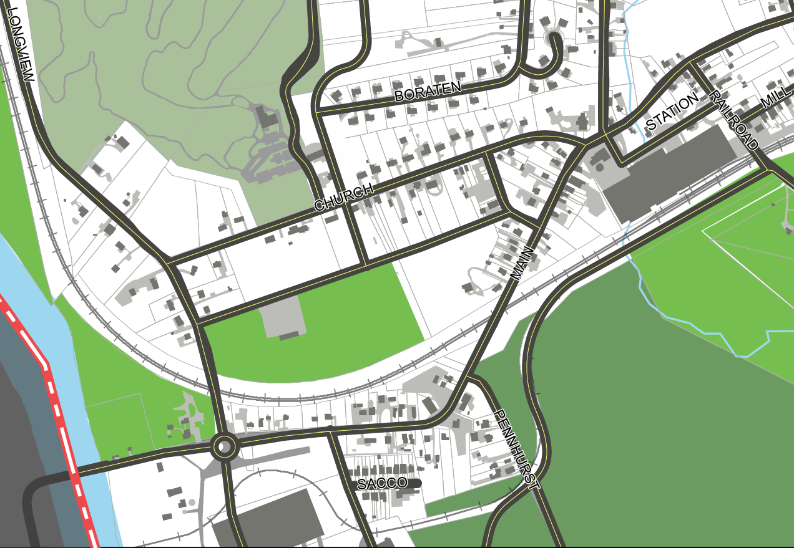
Conceptual Roads

Slide 18
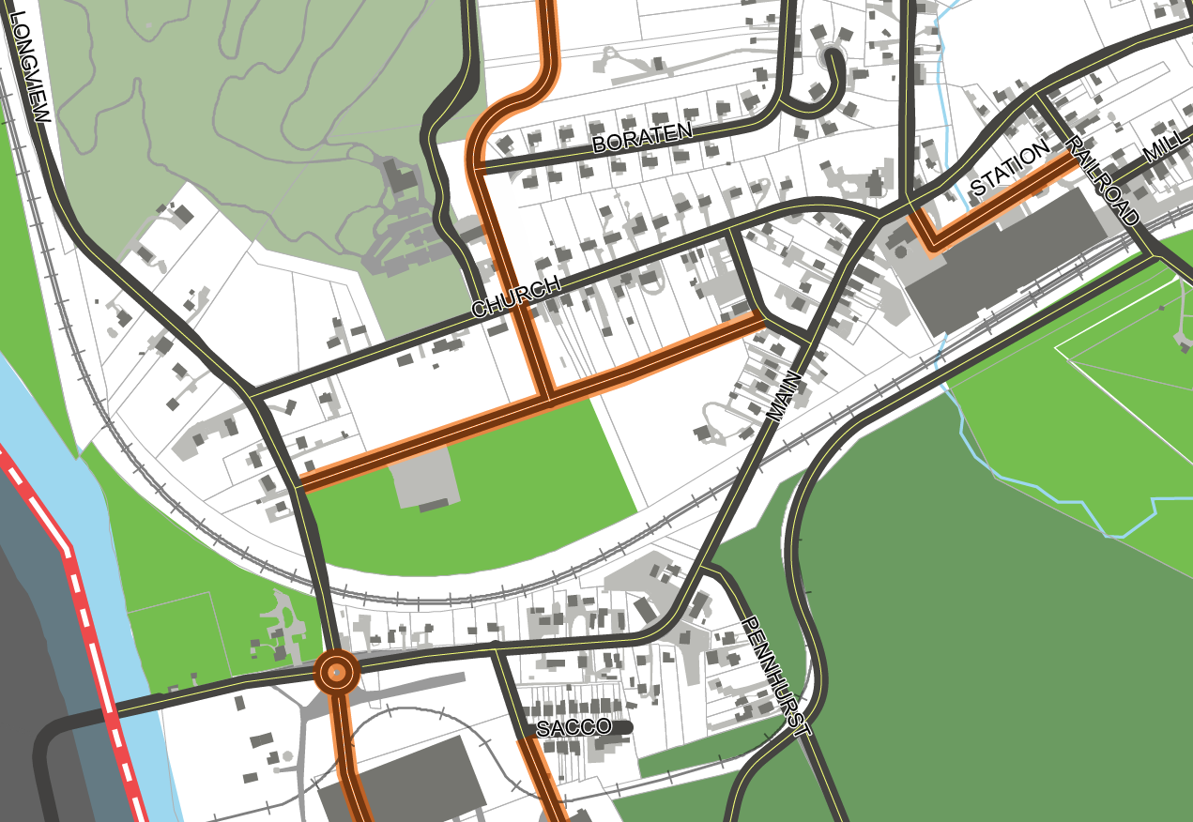
Conceptual Roads
Linfield Sports Park

Slide 19
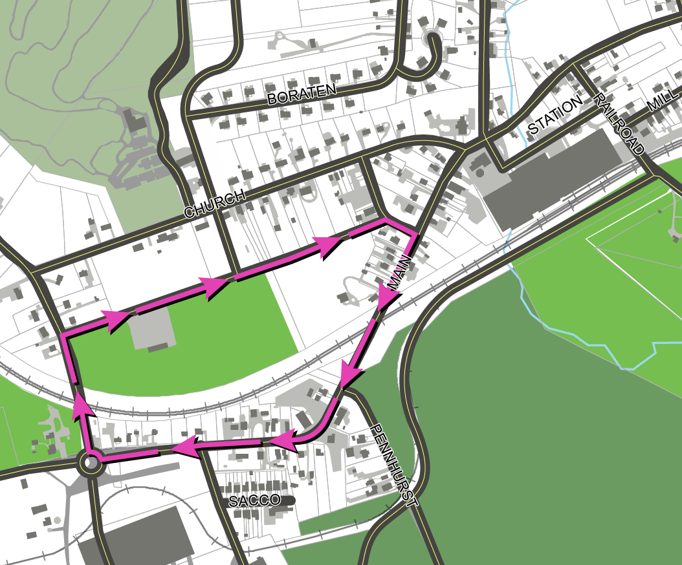
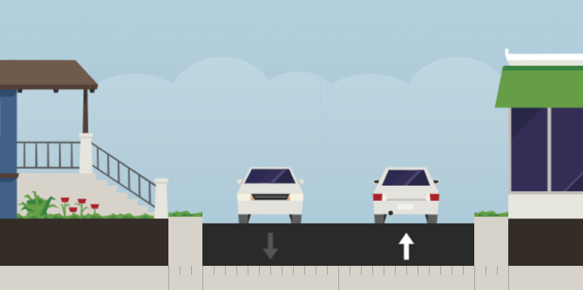
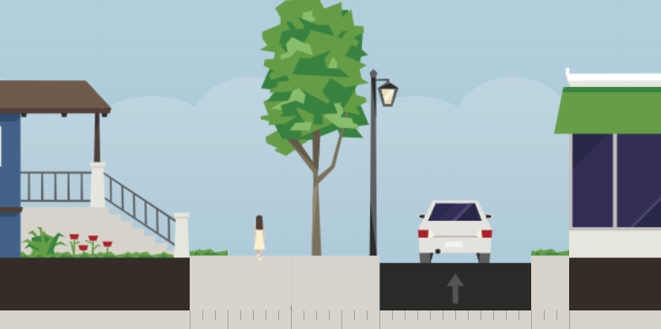
One Way Pair
Opportunities
Chester County eastbound traffic diverted away from Linfield Village, north to Longview Road
One way system creates more room for streetscape elements such as sidewalks on Main Street
EXISTING
Linfield Sports Park
CONCEPTUAL WITH SIDEWALK

Slide 20

Conceptual Sidewalk Network
Sidewalks
Both Sides of Street
One Side of Street
Linfield Sports Park

Slide 21
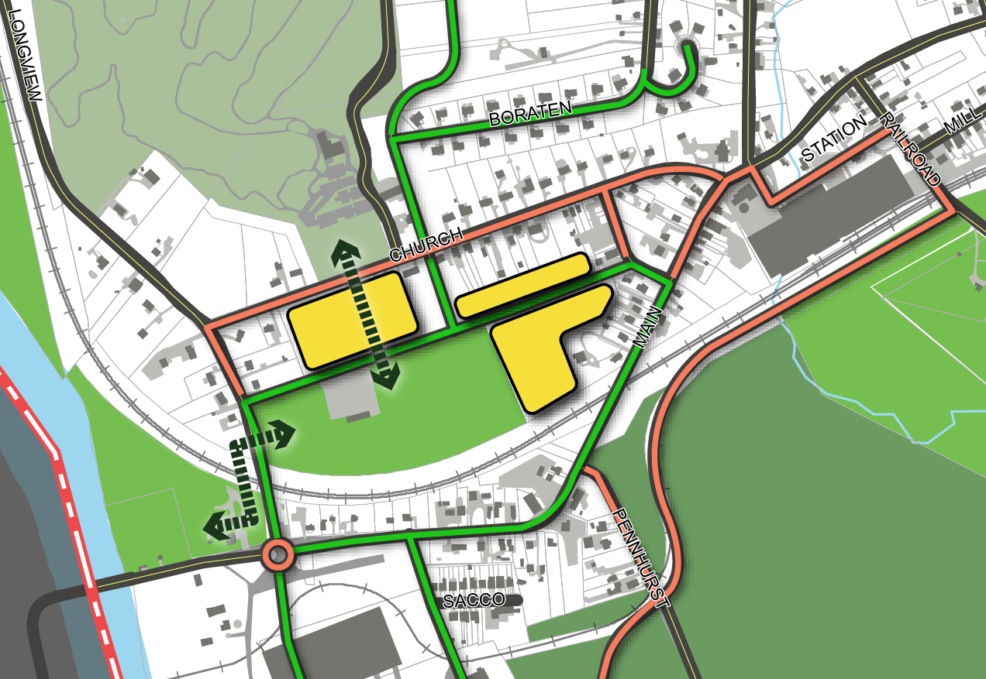
Conceptual Development Alternatives
Sidewalks
Both Sides of Street
One Side of Street
Alternative A:
Linfield Sports Park remains, development occurs along one-way road system
Development areas can be a combination of village commercial or modified residential R-3 Zoning
Conceptual Development Area
Open Space Connections
Linfield Sports Park

Slide 22
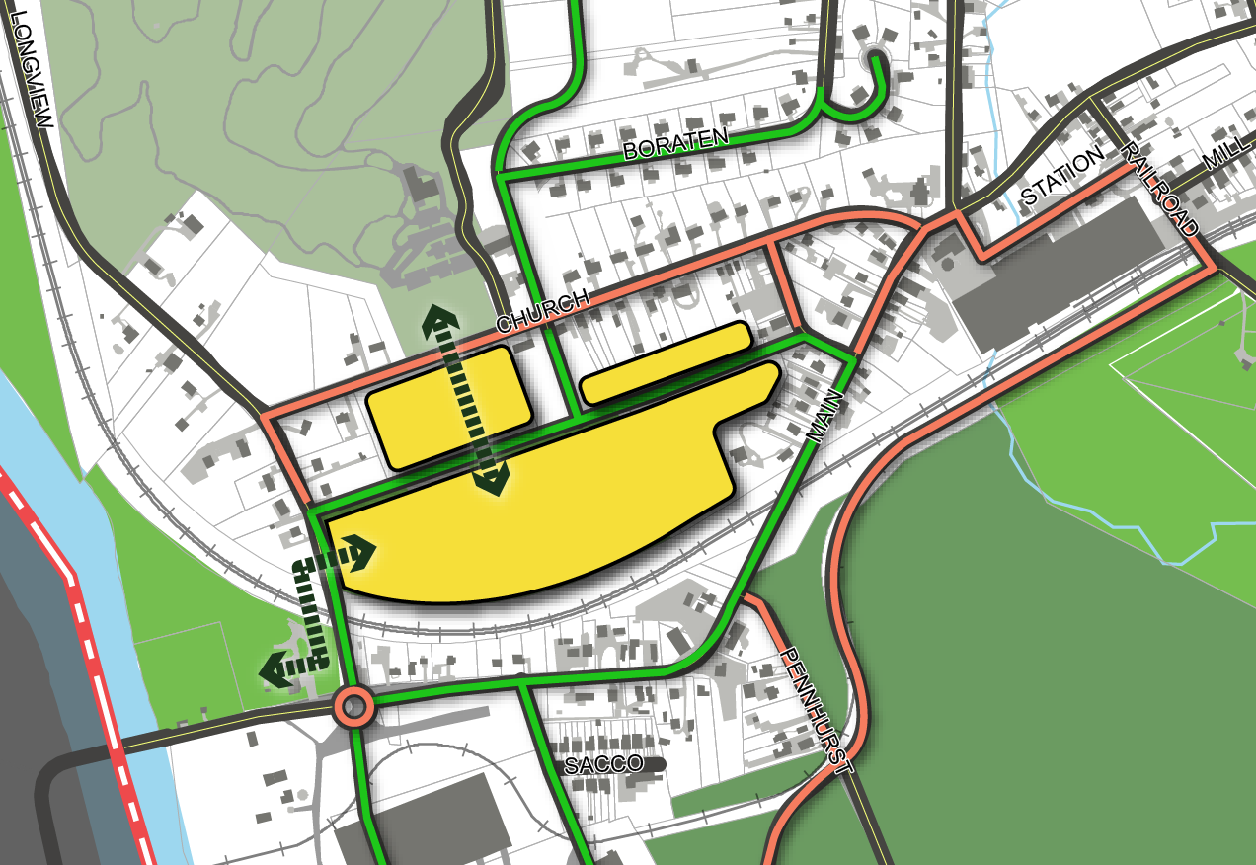
Conceptual Development Alternatives
Sidewalks
Both Sides of Street
One Side of Street
Alternative B:
Linfield Sports Park developed with open space connections north and west
Development areas can be a combination of village commercial or modified residential R-3 Zoning
Park could still be future rail station
Conceptual Development Area
Open Space Connections

Slide 23
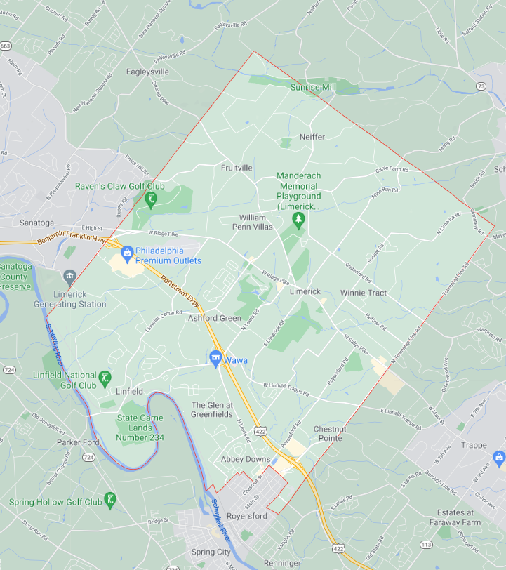
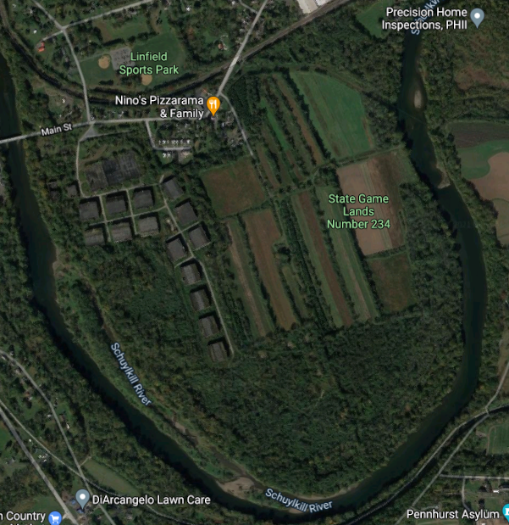
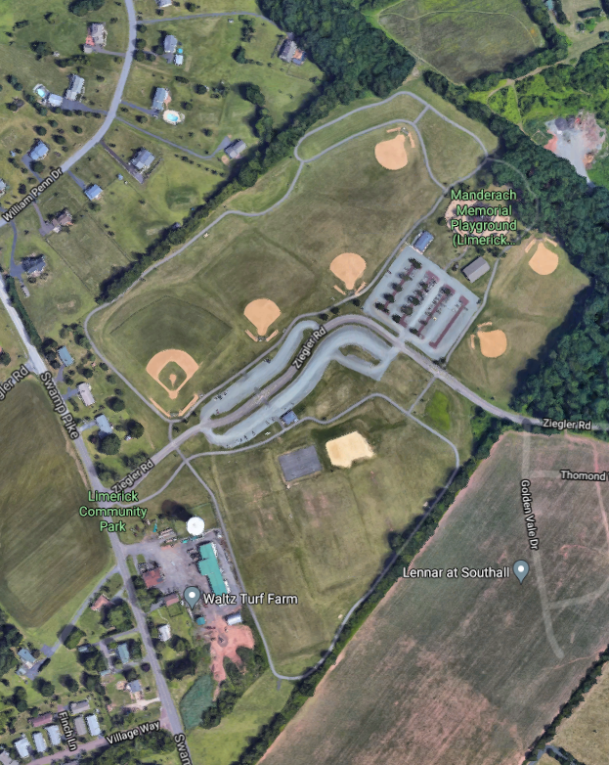
Conceptual Development Alternatives
Alternative B:
Linfield Sports Park currently undersized for demand (softball, soccer, lacrosse)
Programming needs can be met:
  A. SHORT TERM: Limerick Community Park (available 2022/2023)
  B. LONG TERM: Publicker Site
  Need 90’ Baseball Field

Slide 24
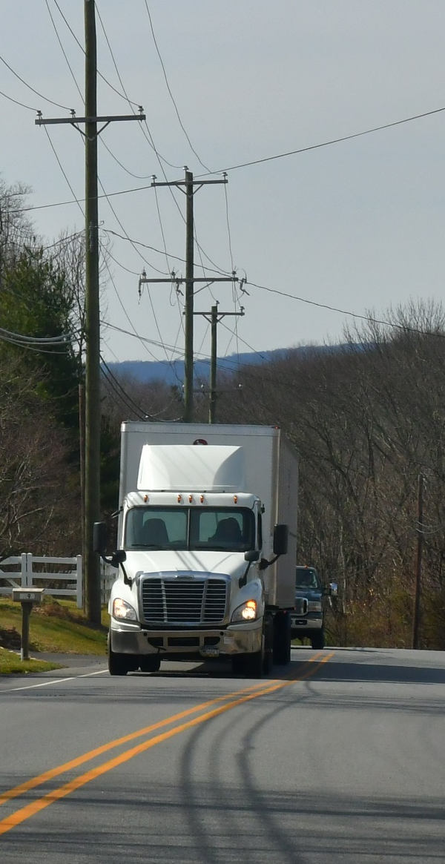
Existing Traffic Issues
Traffic concerns in Linfield Village :
NOT a roadway capacity or traffic volume issue (8,700 Trips Per Day)
IS a speeding issue
  Additional enforcement needed
Linfield Sports Park

Slide 25
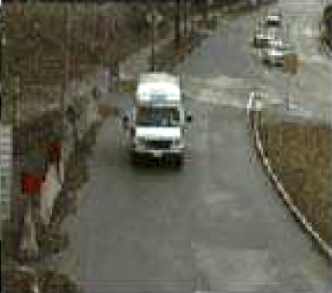
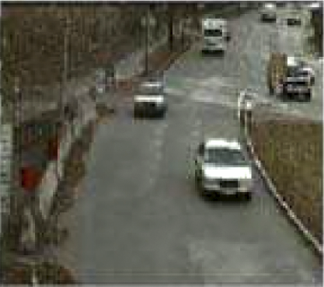
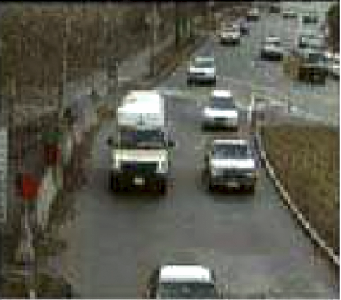
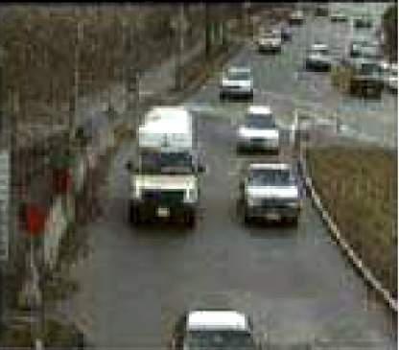
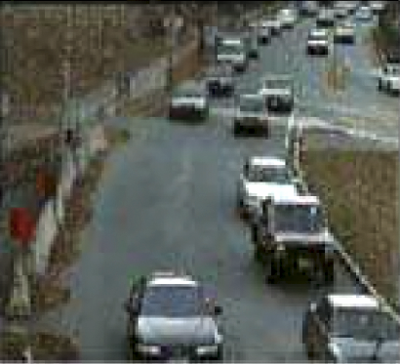
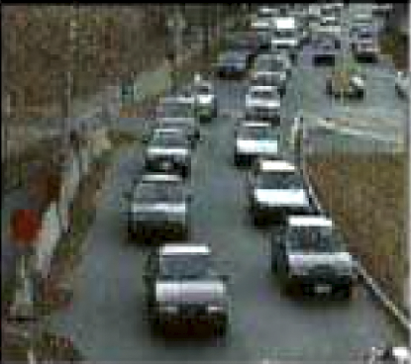
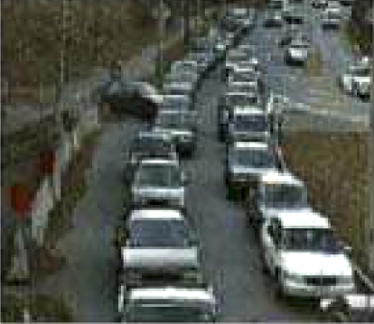
Conceptual Traffic Impacts
Level of Service: Level of service (LOS) is a term used to describe the service level (wait time) of a roadway intersection.
Level of Service – Levels A Through F:
A
B
C
D
E
F
Wait Time:
None
Wait Time:
None
Wait Time:
Minimal
Wait Time:
Noticeable
Wait Time:
Irritating – delays
Wait Time:
Very irritating – long delays

Slide 26
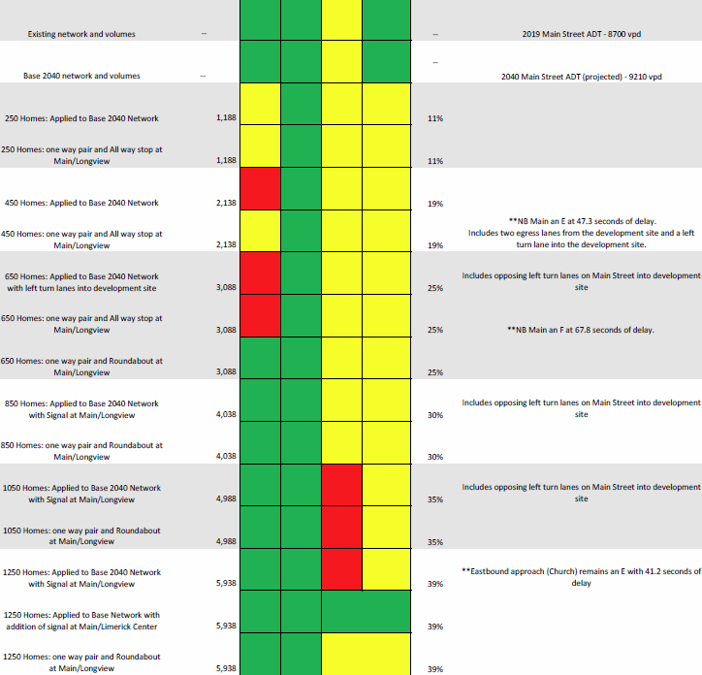
Conceptual Traffic Impacts
Level of Service (LOS) and future development traffic impact analysis has been prepared, will be discussed over the following slides.
LOS shown for PM Peak Hour. AM Peak Hour will be similar.
Long term impacts of Covid and new “work at home” for many will likely not be determined for 5 + years.

Slide 27
Level of Service - Existing Traffic Conditions 2021 & 2040
1
Main at Longview (A/B)
2
Longview at Church (A/B)
3
Main at Church (C/D)
4
Main at Limerick Center (A/B)
4
3
2
Linfield Sports Park
1

Slide 28


Level of Service - 2040 Traffic Conditions + 650 Homes
1
Main at Longview with Roundabout (A/B)
Includes One Way Pairs
2
Longview at Church (A/B)
3
Main at Church (C/D)
4
Main at Limerick Center (C/D)
4
3
2
Linfield Sports Park
1

Slide 29
Level of Service - 2040 Traffic Conditions + 850 Homes
1
Main at Longview with Roundabout (A/B)
Includes One Way Pairs
2
Longview at Church (A/B)
3
Main at Church (C/D)
4
Main at Limerick Center (C/D)
4
3
2
Linfield Sports Park
1

Slide 30
Level of Service - 2040 Traffic Conditions + 1250 Homes
1
Main at Longview with Roundabout (A/B)
Includes One Way Pairs
2
Longview at Church (A/B)
3
Main at Church (C/D)
4
Main at Limerick Center (C/D)
4
3
2
Linfield Sports Park
1

Slide 31


Level of Service - 2040 Traffic Conditions + 1250 Homes
1
Main at Longview (A/B)
2
Longview at Church (A/B)
3
Main at Church (A/B)
4
Main at Limerick Center with new Traffic Signal (A/B)
3
4
2
Linfield Sports Park
1

Slide 32
Conceptual Traffic Impacts
With addition of 1250 units existing levels of service can be maintained with a roundabout, one-way pairs, and traffic signal.
Likely that streetscape improvements will calm traffic and reduce speeds.

Slide 33
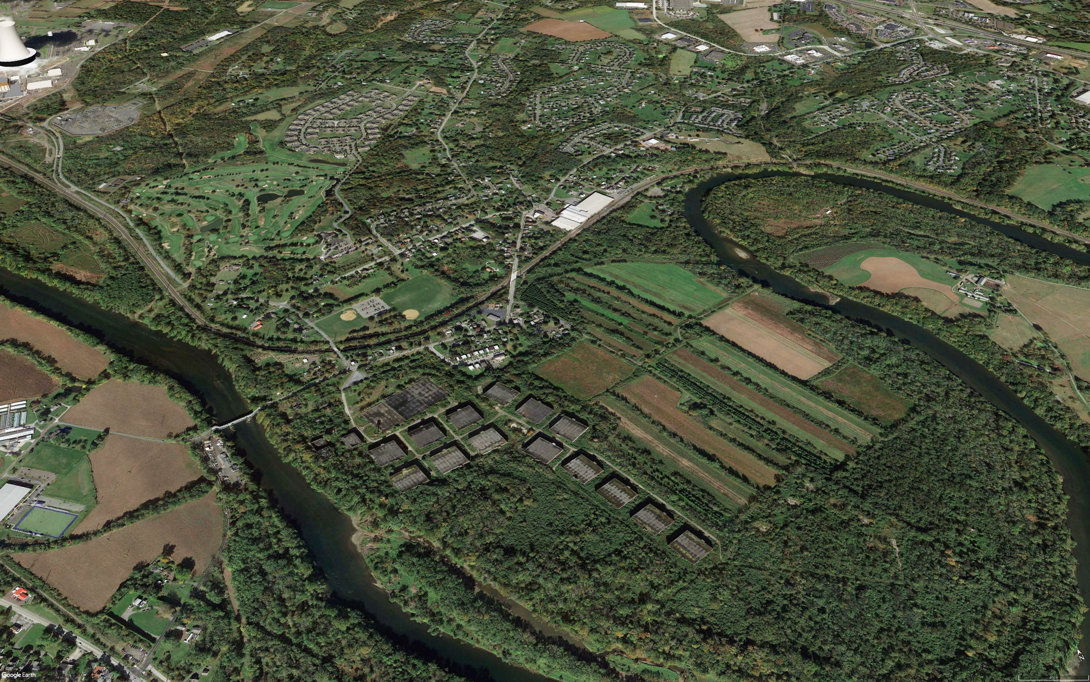
Discussion

Slide 34
Project Schedule

Slide 35
Next Steps
Draft Plan
Refine Roadway, Trail, Open Space Concepts

Slide 36
Thank you!
Simone Collins Landscape Architecture
  610.239.7601
  Peter Simone, RLA, FASLA
    psimone@simonecollins.com
  Pankaj (PJ) Jobanputra, AICP
    pjobanputra@simonecollins.com
  Joe Wallace
    jwallace@simonecollins.com
  Geoff Creary
    gcreary@simonecollins.com
4Ward Planning
  267.480.7133
  Todd Poole
    tpoole@landuseimpacts.com

